Slide 1
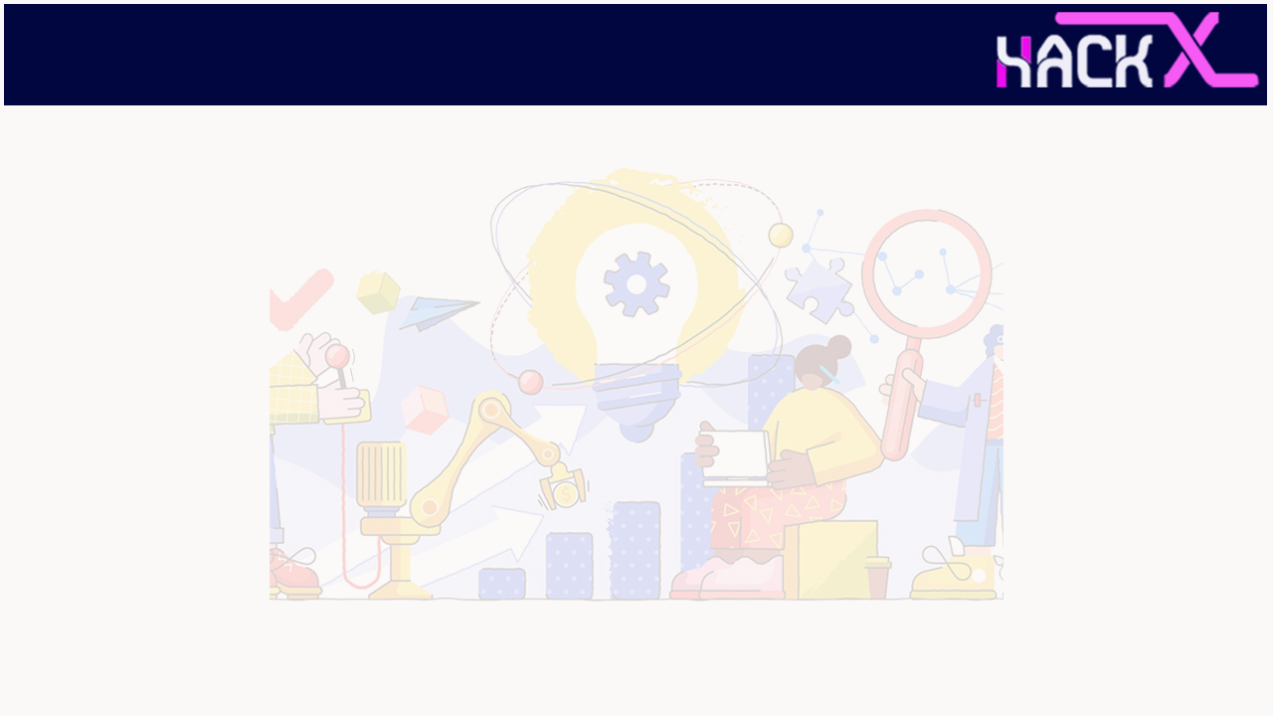
SLIDE 1
Team Name:
Shebytes
2. Members Name and Phone Numbers 1. Sadhana 6380339856
2. Tisha Chawla
3. Pratya Chandrayan
4. Priyanka Kumari
3. Domain name
Open Innovation
4. Problem statement:
Providing support and services to LGBTQ community people

Slide 2
SLIDE 2
ABSTRACT
We have planned to make a website which is intended to work in the direction of helping LGBTQ community to get a proper voice by including exclusive features for them.
We plan to make a platform which will have a separate page where people can write their grievances which in turn will reach to the government.
Keeping in mind that they face problem in their clothing and cannot wear the clothes they like because fitting and design of most of the clothes is meant for a particular gender ,we will have a dressing column which will have clothes for the LGBTQ type from where they can buy stuffs also we will add a selling option on page where they can sell their clothes as well.
Our website will also have a page which will let the Community connect with each other and share their thoughts because we believe that it would make them feel more homely.
THIS ,WE BELIEVE WILL MAKE OUR WEBSITE WHOLESOME AND A UNIQUE ONE

Slide 3
SLIDE 3
NOVELTY
Our idea stands out from others .In today's era when everyone is working in the direction of LGBTQ rights and services ,we believe that this website would be a great step in this direction. We believe it can be a great startup for something big.

Slide 4
SLIDE 4
TECH STACK
To make our website we will be using HTML and CSS along with Javascript ,Node.js, Django ,PHP and databases like MySQL. We will be using chatbots as well which will require a deep understanding of Machine Learning.

Slide 5
SLIDE 6
BUSINESS SCOPE
LGBTQ-owned marketing agencies can take your online growth goals to the next level. 24% of consumers are more likely to do business with an LGBTQIA+ friendly business. Brands are finally realizing that their target audience includes a variety of different types of people, whether it be related to gender, race, sexualitiy, ethnicity, or physical abilities. In 2021, inclusive marketing is a no-brainer because it reflects the real people and lives that are buying your product or service. Long gone are the days of marketing filled with fictional stories and unrealisitcally perfect models.
There aren't a lot of LGBTQIA+-businesses in the market to serve the needs of the people. We want this section of the society to be recognized in every aspect may it be marketing , rights or fashion.

